Slide 1
Digital Logic Design
Fall 2024
(AMD X4 Proc; photo: Sc. Am, Jan. 2010)

Slide 2
Course Description
This course provides a modern introduction to logic design and the basic building blocks used in digital systems, in particular digital computers.
It starts with a discussion of combinational logic: logic gates, minimization techniques, arithmetic circuits, and modern logic devices such as field programmable logic gates.
The second part of the course deals with sequential circuits: flip-flops, synthesis of sequential circuits, and case studies, including counters, registers, and random access memories.
State machines will then be discussed and illustrated through case studies of more complex systems using programmable logic devices. Different representations including truth table, logic gate, timing diagram, switch representation, and state diagram will be discussed.

Slide 3
Course Logistics
Textbook:
"Digital Design: With an Introduction to the Verilog HDL”
M. M. Mano, M. D. Ciletti), 5th ed., Prentice Hall.
Reference Text Book:
"Logic and Computer Design Fundamentals," , by M. Mano and C. Kime,

Slide 5
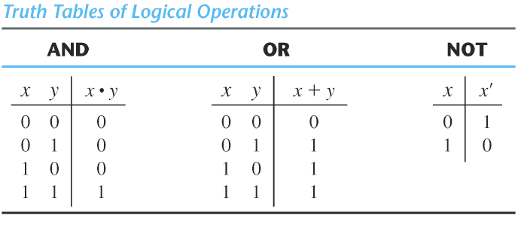

truth table
compact representation of logic operation definition

Slide 6
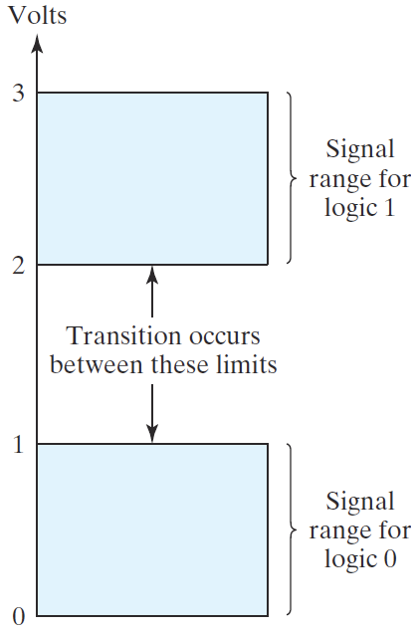
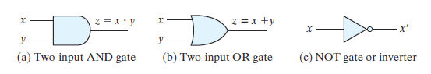

logic gates
electronic circuits
one or more inputs
one output
processing: passing binary signals through gates
symbols
binary signal

Slide 7
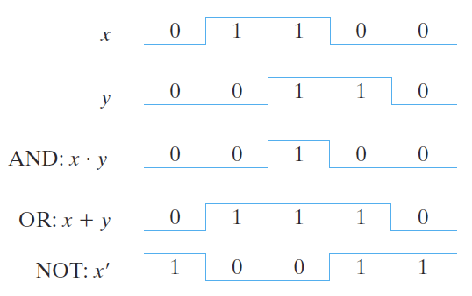
logic gates (contd.)‏
timing diagram

Slide 8
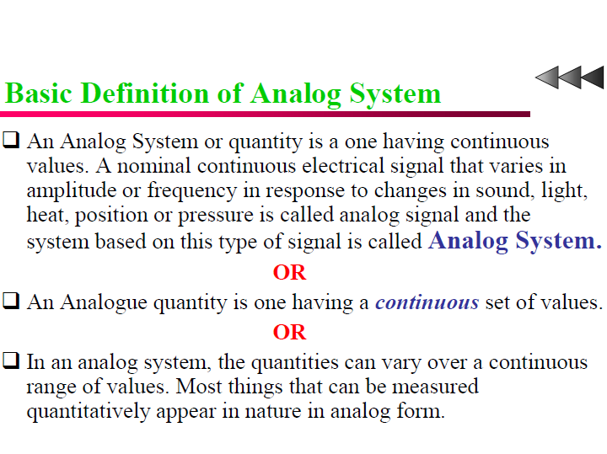

Slide 9
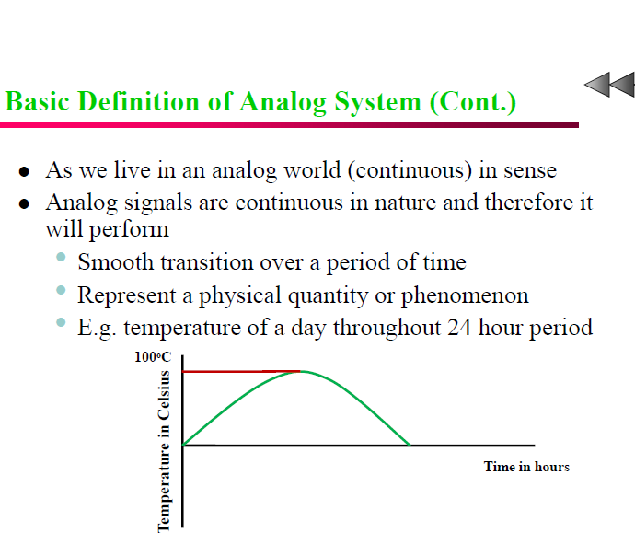

Slide 10
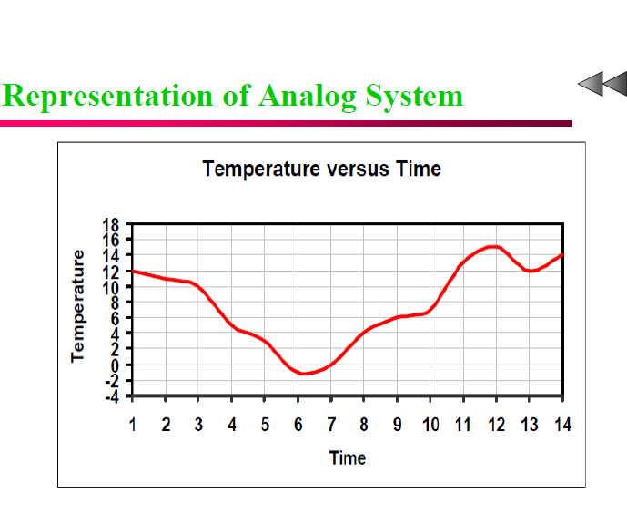

Slide 11
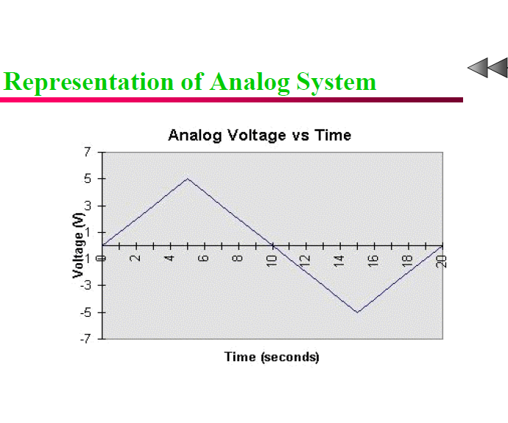

Slide 12
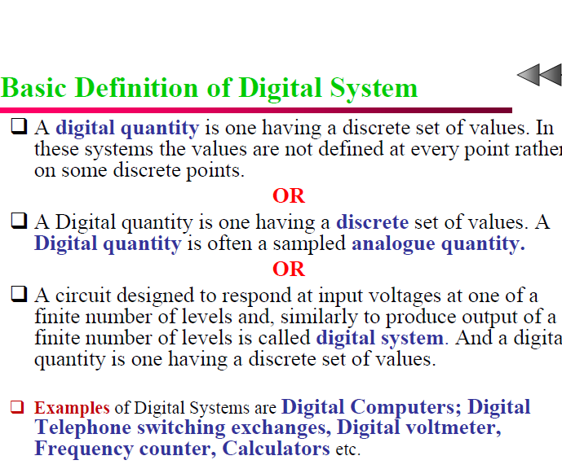

Slide 13
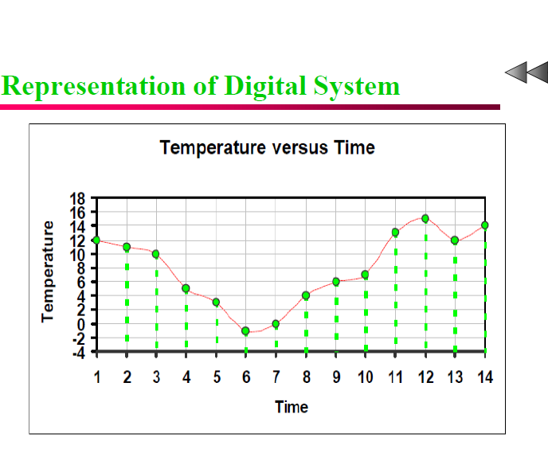

Slide 14
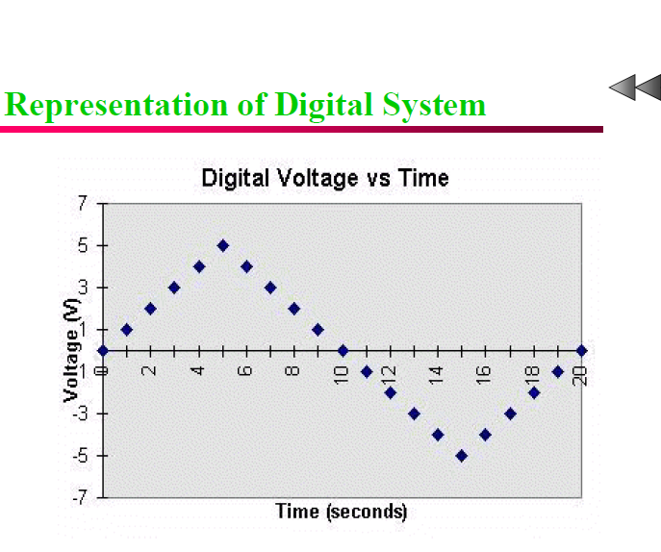

Slide 15
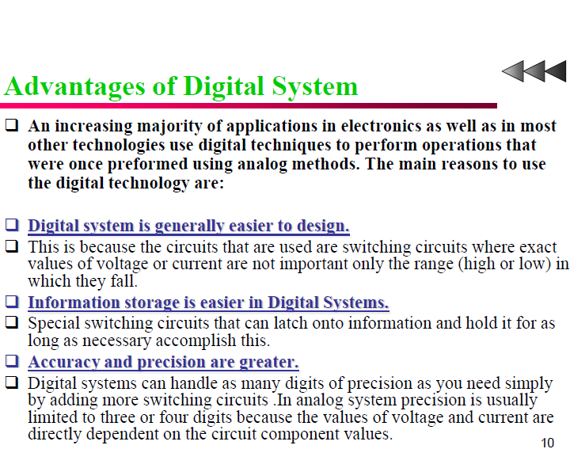

Slide 16
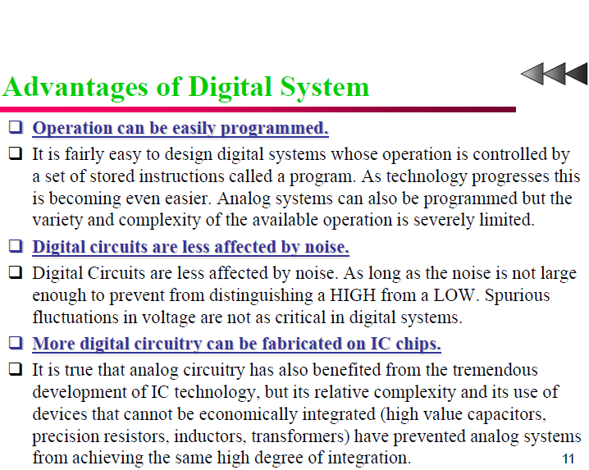

Slide 17
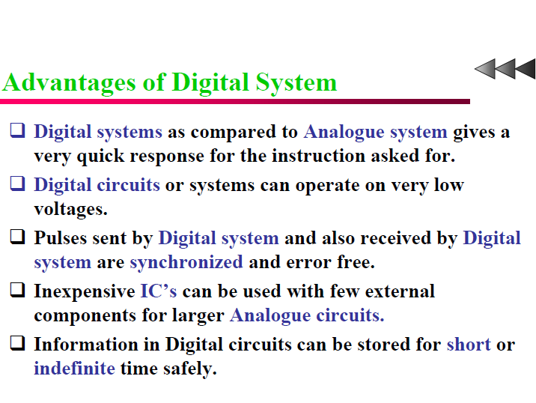

Slide 18
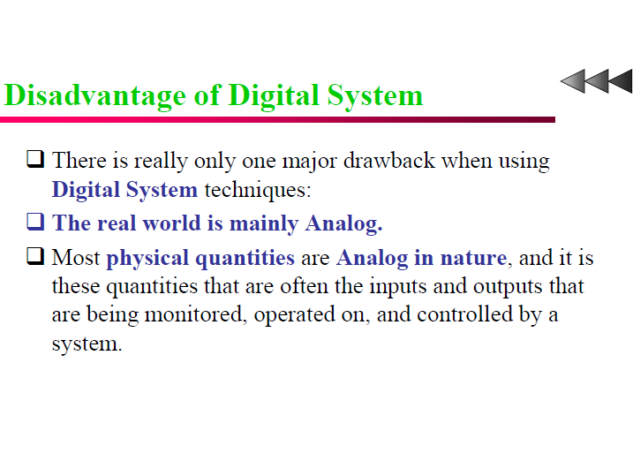

Slide 19
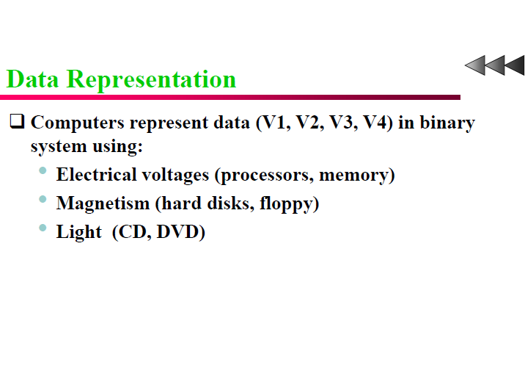

Slide 20
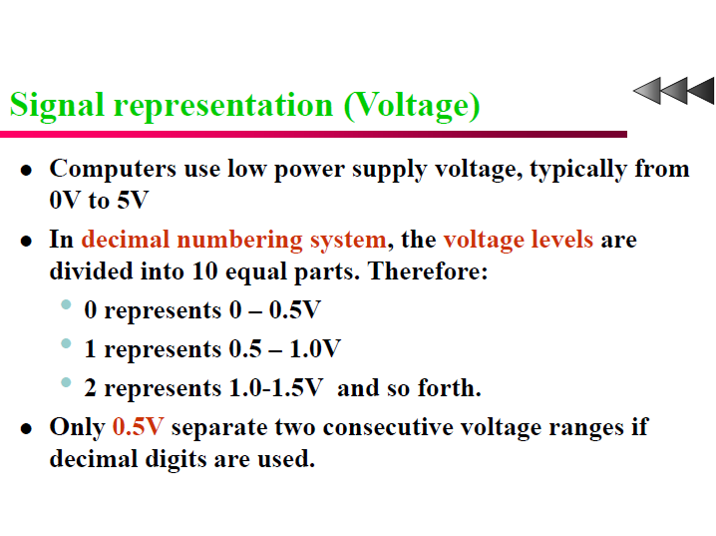

Slide 21
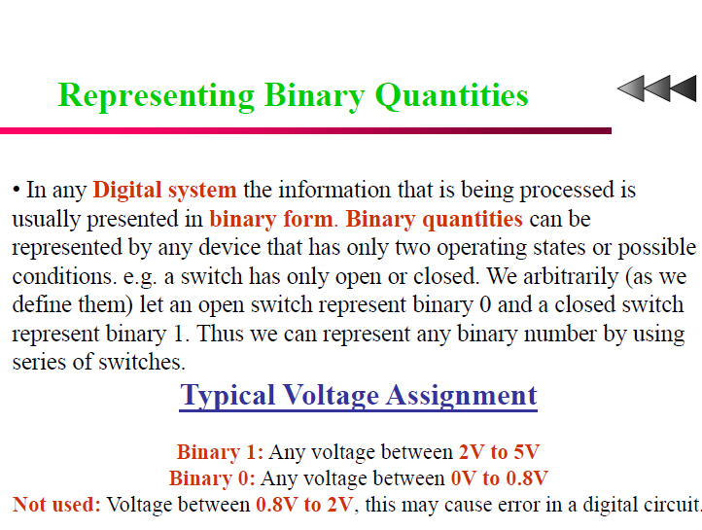

Slide 22
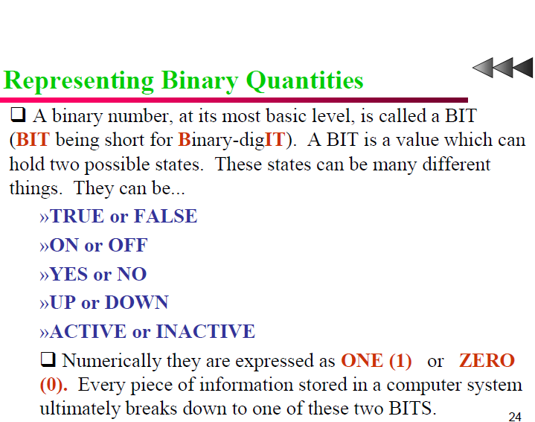

Slide 23
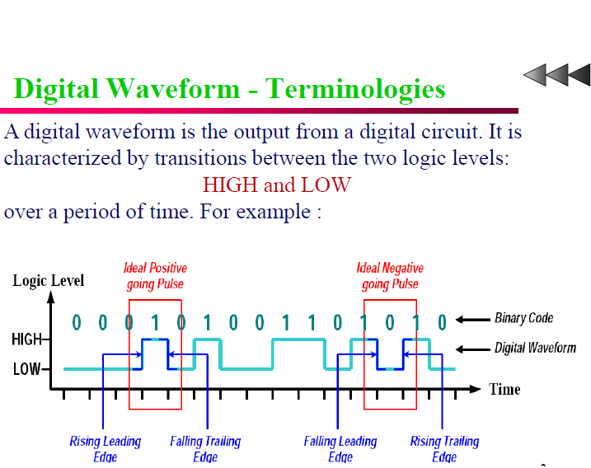

Slide 24
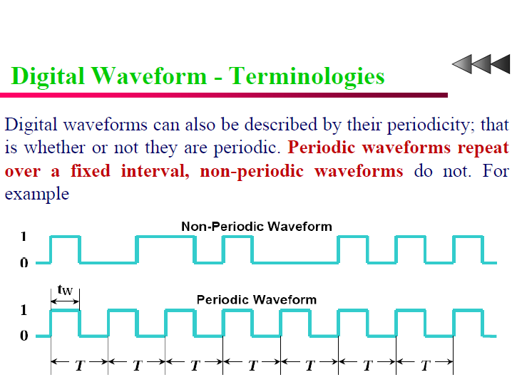

Slide 25
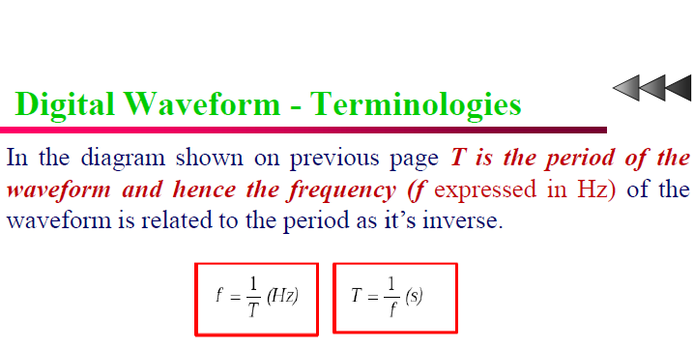

Slide 26
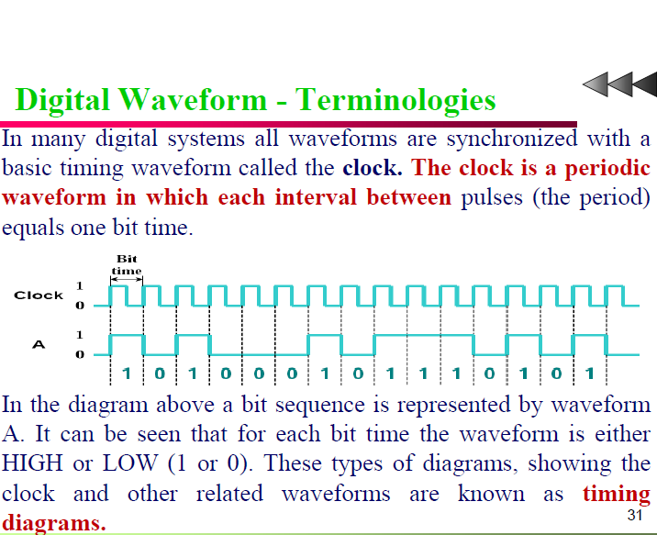

Slide 27
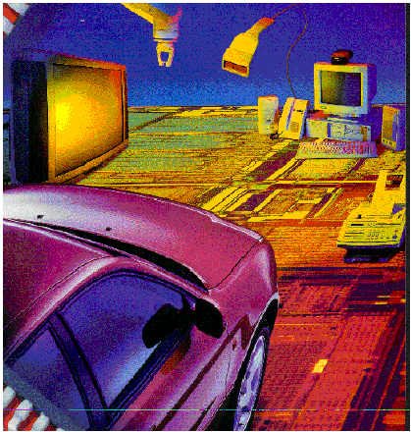
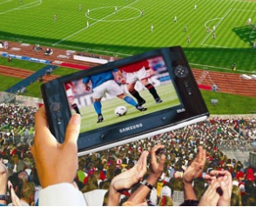

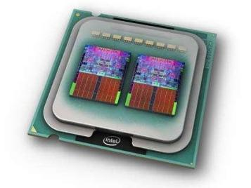
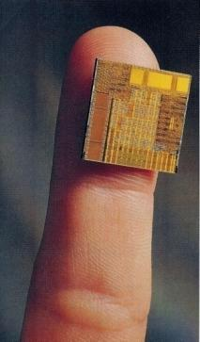
Digital Circuits are Everywhere
Communications
Multi-media
Manufacturing
Consumer electronics
Health care
Defense and security
Software
Automotive, etc
(Source: R. Tummala, IEEE Spectrum, June 2006)

Slide 28
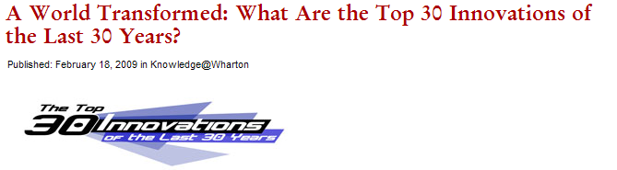
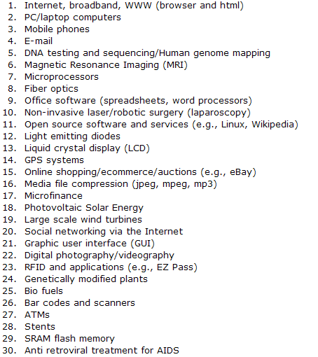
Life Changers
Of these 30 innovations , 10 are directly related to advances in Digital Logic and Solid State Circuits;
Another 8 are the indirect results of ICs.
See artilcel at: http://knowledge.wharton.upenn.edu/article.cfm?articleid=2163
Notes:
Nightly business report on PBS: Top innovations of the last 30 yrs, according to judges at the Univ. of Pennsylvania’s Wharton School

Slide 29
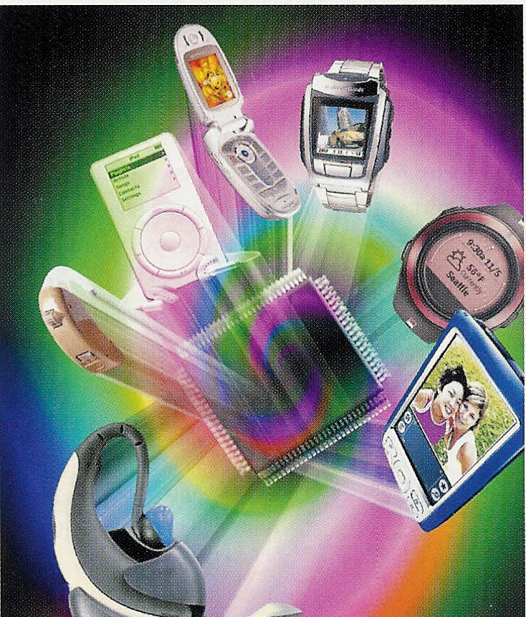
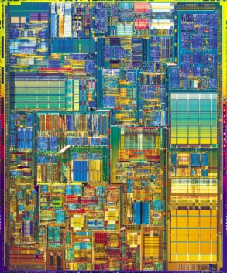

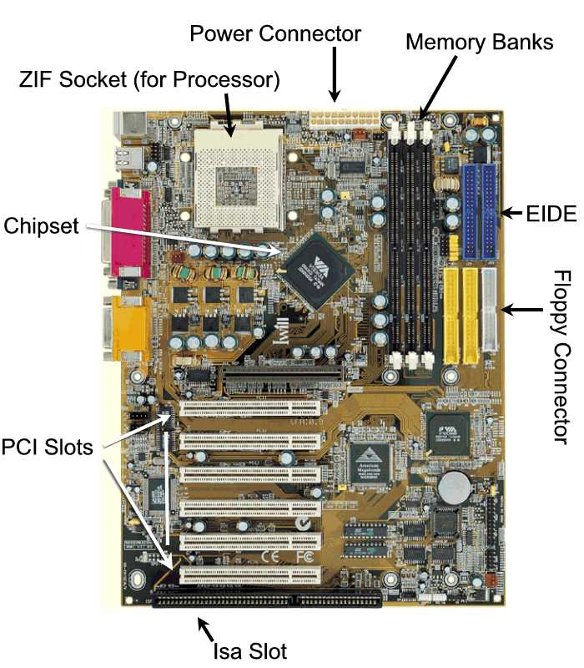
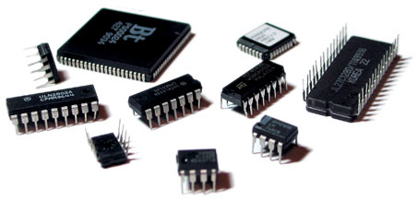
Deals with building blocks of digital systems
?
(Intel)
EE Times, Berkeley Design Tech.
(D. Rommel)
Notes:
PCI: Peripheral Component Interconnect
ISA: Industrial Standard Architecture
EIDE (Enhanced Integrated Drive Electronics: connects that connect cables for Hard drives, Floppy drives.

Slide 30
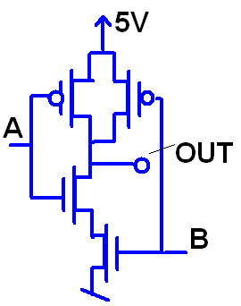
What are Logic Gates built from?
Transistors:
The transistor is the workhorse of every electronic device.
Transistor
Digital building blocks

Slide 31
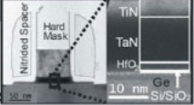
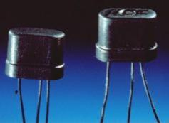
What is a Transistor?
Electronic, solid-state device that can amplify an electric signal:
V_{out} > V_{in}
Power_{out} > Power_{in}
in
S
out
transistor
B
(Source: IMEC)
Id
output
input
Mike

Slide 32
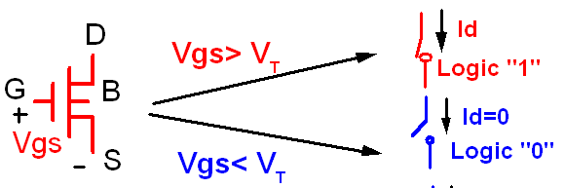
Digital Model of a Transistor
We make abstraction of the signals: 0 or 1
As a result a transistors can be considered a switch (on or off; 1 or ;):

Slide 33
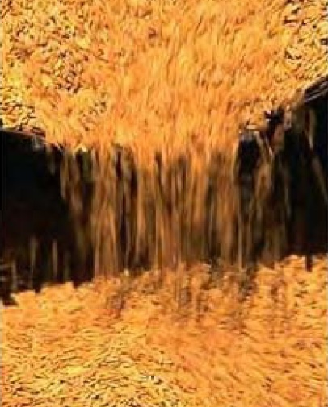
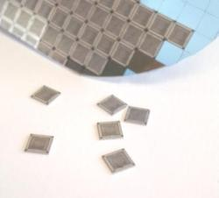
Ten quintillion
Ten quintillion: 10x10¹⁸
Is about the number grains of rice harvested in 2004
Number of transistors fabricated in 2004
In 2008: 1B transistors fabricated/capita

Slide 34

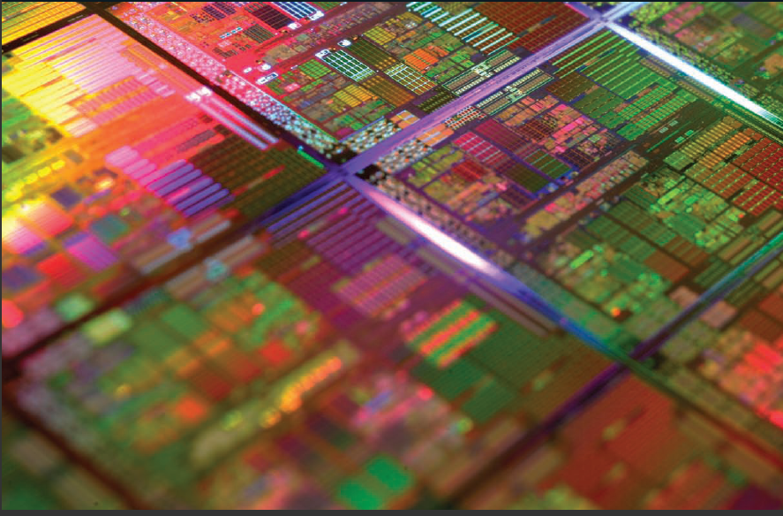
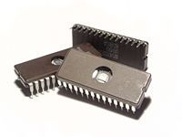
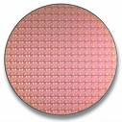
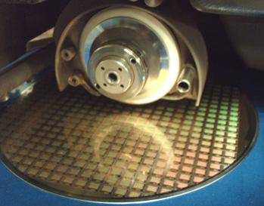
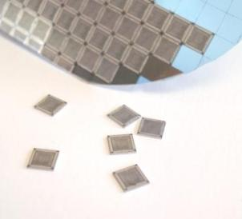
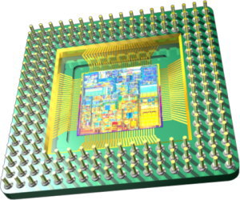
What is an IC?
An Integrated Circuit is a miniaturized electronic circuits whose components (transistors, resistors, capacitors) are build on the surface of a semiconductor wafer, using the same planar fabrication technology.
(Source: http://www.majelac.com/images/wafer_dicing.jpg)
(Source: Wikipedia)
(Picture: Scientific American, Jan. 2010)

Slide 35
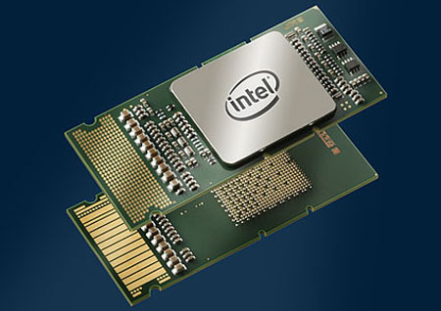
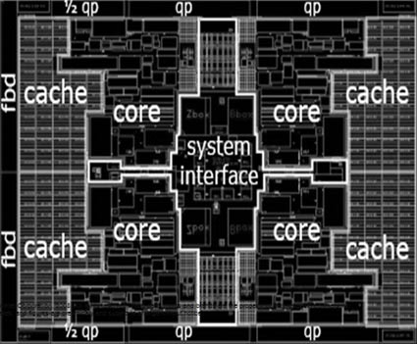
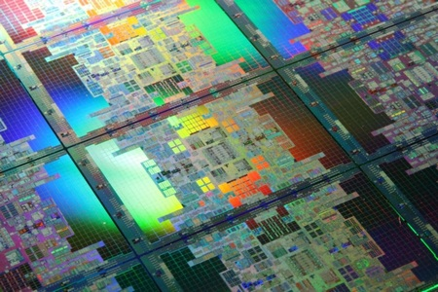
Intel Itanium 9300 Tukwila Processor
(source: www.tgdaily.com)
Four cores
Over 2 billion transistors!

Slide 36


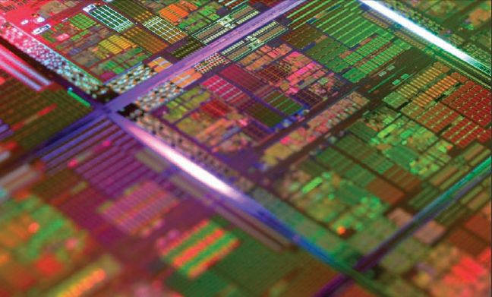
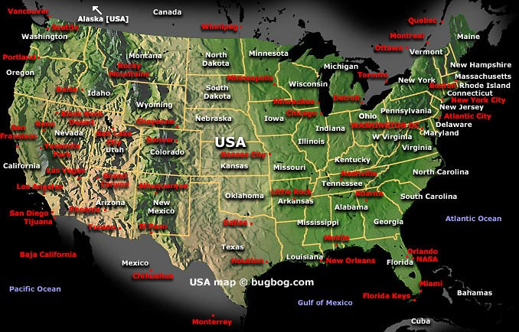

Chip complexity
Complexity of the USA
(AMD X4 Proc: 758 million transistors; photo: Sc. Am, Jan. 2010)
Submicron and nanoscale dimensions
Compare to a street map

Slide 37

World of the Small
Circuit Level
5 layers of interconnections
Chip level
(VLSI)
(IBM Corp.)
Logic Level

Slide 38



Moore’s Law
Chip complexity doubles every two years
First 2-Billion Trans. Processor (Tukwila: Itanium processor); Production Q1, 2010

Slide 39
1. Number Systems

Slide 40

Notes:
https://www.sliderulemuseum.com/Abaci/THE_ABACUS_HANDBOOK.pdf

Slide 41

Human perception
We naturally live in a base 10 environment
Computer exist in a base 2 environment
So give the computer/digital system the task of doing the conversions for us.

Slide 42
Binary Codes
“An n-bit binary code is a group of n bits that assume up to 2^{n} distinct combinations of 1s and 0s, with each combination representing one element of the set being coded”
For the 10 digits need a 4 bit code. One code is called Binary Coded Decimal (BCD)

Slide 43
There are 10 kinds of people in the world:
those who understand binary numerals, and
those who don't.

Slide 44
Decimal and BCD
The BCD is simply the 4 bit representation of the decimal digit.
For multiple digit base 10 numbers, each symbol is represented by its BCD digit
What happened to 6 digits not used?

Slide 45
Common Number Systems
System | Base | Symbols | Used by humans? | Used in computers?
Decimal | 10 | 0, 1, … 9 | Yes | No
Binary | 2 | 0, 1 | No | Yes
Octal | 8 | 0, 1, … 7 | No | No
Hexa- decimal | 16 | 0, 1, … 9, A, B, … F | No | No

Slide 46
Quantities/Counting (1 of 3)
Decimal | Binary | Octal | Hexa- decimal
0 | 0 | 0 | 0
1 | 1 | 1 | 1
2 | 10 | 2 | 2
3 | 11 | 3 | 3
4 | 100 | 4 | 4
5 | 101 | 5 | 5
6 | 110 | 6 | 6
7 | 111 | 7 | 7
p. 33

Slide 47
Quantities/Counting (2 of 3)
Decimal | Binary | Octal | Hexa- decimal
8 | 1000 | 10 | 8
9 | 1001 | 11 | 9
10 | 1010 | 12 | A
11 | 1011 | 13 | B
12 | 1100 | 14 | C
13 | 1101 | 15 | D
14 | 1110 | 16 | E
15 | 1111 | 17 | F

Slide 48
Quantities/Counting (3 of 3)
Decimal | Binary | Octal | Hexa- decimal
16 | 10000 | 20 | 10
17 | 10001 | 21 | 11
18 | 10010 | 22 | 12
19 | 10011 | 23 | 13
20 | 10100 | 24 | 14
21 | 10101 | 25 | 15
22 | 10110 | 26 | 16
23 | 10111 | 27 | 17
Etc.

Slide 49
Conversion - Summary
Divisions by 16
∑A_{i}.16^{i}
Hexadecimal
Decimal
Divisons by 2
ΣA_{i}.2^{i}
Group in bits of 4
Binary
Divisions by 8
Octal ↔Hex: through the binary representation
Group in bits of 3
∑ A_{i}.8^{i}
Octal

Slide 50
Conversion Among Bases
The possibilities:
Decimal
Octal
Binary
Hexadecimal
pp. 40-46

Slide 51
Quick Example
25₁₀ = 11001₂ = 31₈ = 19₁₆
Base

Slide 52
Decimal to Decimal (just for fun)
Decimal
Octal
Binary
Hexadecimal
Next slide…

Slide 53
Weight
125₁₀ => 5 x 10⁰ = 5 2 x 10¹ = 20 1 x 10² = 100 125
Base

Slide 54
Binary to Decimal
Decimal
Octal
Binary
Hexadecimal

Slide 55
Binary to Decimal
Technique
Multiply each bit by 2^{n}, where n is the “weight” of the bit
The weight is the position of the bit, starting from 0 on the right
Add the results

Slide 56
Example
Bit “0”
101011₂ => 1 x 2⁰ = 1 1 x 2¹ = 2 0 x 2² = 0 1 x 2³ = 8 0 x 2⁴ = 0 1 x 2⁵ = 32
43₁₀

Slide 57
Octal to Decimal
Decimal
Octal
Binary
Hexadecimal

Slide 58
Octal to Decimal
Technique
Multiply each bit by 8^{n}, where n is the “weight” of the bit
The weight is the position of the bit, starting from 0 on the right
Add the results

Slide 59
Example
724₈ => 4 x 8⁰ = 4 2 x 8¹ = 16 7 x 8² = 448 468₁₀

Slide 60
Hexadecimal to Decimal
Decimal
Octal
Binary
Hexadecimal

Slide 61
Hexadecimal to Decimal
Technique
Multiply each bit by 16^{n}, where n is the “weight” of the bit
The weight is the position of the bit, starting from 0 on the right
Add the results

Slide 62
Example
ABC₁₆ => C x 16⁰ = 12 x 1 = 12 B x 16¹ = 11 x 16 = 176 A x 16² = 10 x 256 = 2560
2748₁₀

Slide 63
Decimal to Binary
Decimal
Octal
Binary
Hexadecimal

Slide 64
Decimal to Binary
Technique
Divide by two, keep track of the remainder
First remainder is bit 0 (LSB, least-significant bit)
Second remainder is bit 1
Etc.

Slide 65
Example
125₁₀ = ?₂
2 125 62 1
2 31 0
2 15 1
2 7 1
2 3 1
2 1 1
2 0 1
125₁₀ = 1111101₂

Slide 66
Octal to Binary
Decimal
Octal
Binary
Hexadecimal

Slide 67
Octal to Binary
Technique
Convert each octal digit to a 3-bit equivalent binary representation

Slide 68
Example
705₈ = ?₂
7 0 5
111 000 101
705₈ = 111000101₂

Slide 69
Hexadecimal to Binary
Decimal
Octal
Binary
Hexadecimal

Slide 70
Hexadecimal to Binary
Technique
Convert each hexadecimal digit to a 4-bit equivalent binary representation

Slide 71
Example
10AF₁₆ = ?₂
1 0 A F
0001 0000 1010 1111
10AF₁₆ = 0001000010101111₂

Slide 72
Decimal to Octal
Decimal
Octal
Binary
Hexadecimal

Slide 73
Decimal to Octal
Technique
Divide by 8
Keep track of the remainder

Slide 74
Example
1234₁₀ = ?₈
8 1234
154 2
8
19 2
8
2 3
8
0 2
1234₁₀ = 2322₈

Slide 75
Decimal to Hexadecimal
Decimal
Octal
Binary
Hexadecimal

Slide 76
Decimal to Hexadecimal
Technique
Divide by 16
Keep track of the remainder

Slide 77
Example
1234₁₀ = ?₁₆
16 1234
77 2
16
4 13 = D
16
0 4
1234₁₀ = 4D2₁₆

Slide 78
Binary to Octal
Decimal
Octal
Binary
Hexadecimal

Slide 79
Binary to Octal
Technique
Group bits in threes, starting on right
Convert to octal digits

Slide 80
Example
1011010111₂ = ?₈
1 011 010 111
1 3 2 7
1011010111₂ = 1327₈

Slide 81
Binary to Hexadecimal
Decimal
Octal
Binary
Hexadecimal

Slide 82
Binary to Hexadecimal
Technique
Group bits in fours, starting on right
Convert to hexadecimal digits

Slide 83
Example
1010111011₂ = ?₁₆
10 1011 1011
B B
1010111011₂ = 2BB₁₆

Slide 84
Octal to Hexadecimal
Decimal
Octal
Binary
Hexadecimal

Slide 85
Octal to Hexadecimal
Technique
Use binary as an intermediary

Slide 86
Example
1076₈ = ?₁₆
1 0 7 6
001 000 111 110
2 3 E
1076₈ = 23E₁₆

Slide 87
Hexadecimal to Octal
Decimal
Octal
Binary
Hexadecimal

Slide 88
Hexadecimal to Octal
Technique
Use binary as an intermediary

Slide 89
Example
1F0C₁₆ = ?₈
1 F 0 C
0001 1111 0000 1100
1 7 4 1 4
1F0C₁₆ = 17414₈

Slide 90
Exercise – Convert ...
Decimal | Binary | Octal | Hexa- decimal
33
 | 1110101
 |  | 703
 |  |  | 1AF
Don’t use a calculator!

Slide 91
Common Powers (1 of 2)
Base 10
Power | Preface | Symbol
10⁻¹² | pico | p
10⁻⁹ | nano | n
10⁻⁶ | micro | μ
10⁻³ | milli | m
10³ | kilo | k
10⁶ | mega | M
10⁹ | giga | G
10¹² | tera | T
Value
.000000000001
.000000001
.000001
.001
1000
1000000
1000000000
1000000000000

Slide 92
Common Powers (2 of 2)
Base 2
Power | Preface | Symbol
2¹⁰ | kilo | k
2²⁰ | mega | M
2³⁰ | Giga | G
Value
1024
1048576
1073741824
What is the value of “k”, “M”, and “G”?
In computing, particularly w.r.t. memory, the base-2 interpretation generally applies

Slide 93

Example
In the lab… 1. Double click on My Computer 2. Right click on C: 3. Click on Properties
/ 2³⁰ =

Slide 94
Review – multiplying powers
For common bases, add powers
a^{b} × a^{c} = a^{b+c}
2⁶ × 2¹⁰ = 2¹⁶ = 65,536
or…
2⁶ × 2¹⁰ = 64 × 2¹⁰ = 64k

Slide 95
Binary Addition (1 of 2)
Two 1-bit values
A | B | A + B
0 | 0 | 0
0 | 1 | 1
1 | 0 | 1
1 | 1 | 10
“two”
pp. 36-38

Slide 96
Binary Addition (2 of 2)
Two n-bit values
Add individual bits
Propagate carries
E.g.,
1
1
10101 21 + 11001 + 25 101110 46

Slide 97
Multiplication (1 of 3)
Decimal (just for fun)
35 x 105 175 000 35 3675
pp. 39

Slide 98
Multiplication (2 of 3)
Binary, two 1-bit values
A | B | A × B
0 | 0 | 0
0 | 1 | 0
1 | 0 | 0
1 | 1 | 1

Slide 99
Multiplication (3 of 3)
Binary, two n-bit values
As with decimal values
E.g.,
1110 x 1011 1110 1110 0000 1110 10011010

Slide 100
Fractions
Decimal to decimal (just for fun)
3.14 => 4 x 10⁻² = 0.04 1 x 10⁻¹ = 0.1 3 x 10⁰ = 3 3.14
pp. 46-50

Slide 101
Fractions
Binary to decimal
10.1011 => 1 x 2⁻⁴ = 0.0625 1 x 2⁻³ = 0.125 0 x 2⁻² = 0.0 1 x 2⁻¹ = 0.5 0 x 2⁰ = 0.0 1 x 2¹ = 2.0 2.6875
pp. 46-50

Slide 102
Fractions
.14579 x 2 0.29158 x 2 0.58316 x 2 1.16632 x 2 0.33264 x 2 0.66528 x 2 1.33056
etc.
Decimal to binary
3.14579
11.001001...
p. 50

Slide 103
Exercise – Convert ...
Decimal | Binary | Octal | Hexa- decimal
29.8
 | 101.1101
 |  | 3.07
 |  |  | C.82
Don’t use a calculator!
Answer

Slide 104
Conversion - Summary
Divisions by 16
∑A_{i}.16^{i}
Hexadecimal
Decimal
Divisons by 2
ΣA_{i}.2^{i}
Group in bits of 4
Binary
Divisions by 8
Octal ↔Hex: through the binary representation
Group in bits of 3
∑ A_{i}.8^{i}
Octal

Slide 105
Binary Arithmetic

Slide 106


Slide 107


Slide 108


Slide 109


Slide 110


Slide 111


Slide 112


Slide 113


Slide 114


Slide 115


Slide 116


Slide 117


Slide 118


Slide 119


Slide 120


Slide 121


Slide 122


Slide 123


Slide 124


Slide 125


Slide 126


Slide 127


Slide 128


Slide 129


Slide 130


Slide 131


Slide 132


Slide 133


Slide 134


Slide 135


Slide 136


Slide 137


Slide 138


Slide 139


Slide 140


Slide 141


Slide 142


Slide 143


Slide 144


Slide 145


Slide 146
Codes

Slide 148

BCD

Slide 149

BCD

Slide 150

BCD

Slide 151

BCD

Slide 152

BCD Addition

Slide 153

BCD Additions

Slide 154

Invalid Case

Slide 155

BCD Addition Example

Slide 156

BCD Addition Example

Slide 157

BCD Addition Example

Slide 158

Codes

Slide 159

GRAY Codes

Slide 160


Slide 161

Binary to Gray Code Conversion

Slide 162

Binary to Gray Code Conversion

Slide 163

Binary to Gray Code Conversion

Slide 164

Binary to Gray Code Conversion

Slide 165


Slide 166

ASCII

Slide 167

ASCII

Slide 168


Slide 169

ASCII

Slide 170


